Slide 1


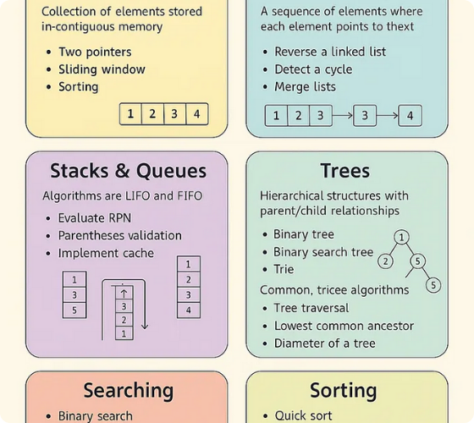
DSA INTERVIEW PREP
Array Interview Problems
Mastering Trapping Rain Water and Stock Profit patterns for top-tier tech interviews.

Slide 2

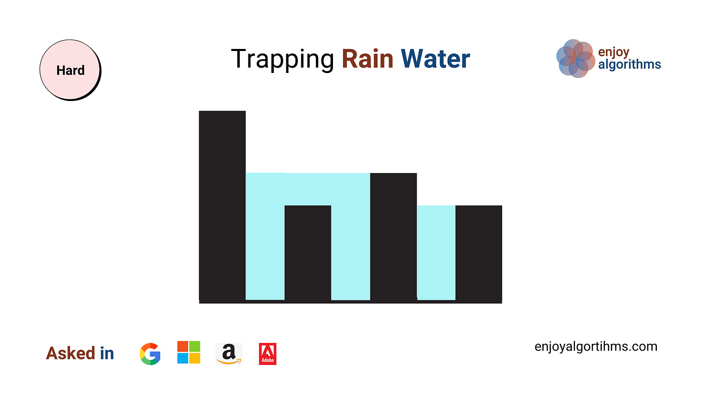
Problem 1: Trapping Rain Water
Given an array of non-negative integers representing an elevation map where the width of each bar is 1, compute how much water it can trap after raining.
Input: height = [4, 2, 0, 3, 2, 5]
Output: 9 units of water
Water is trapped between two tall bars.

Slide 3
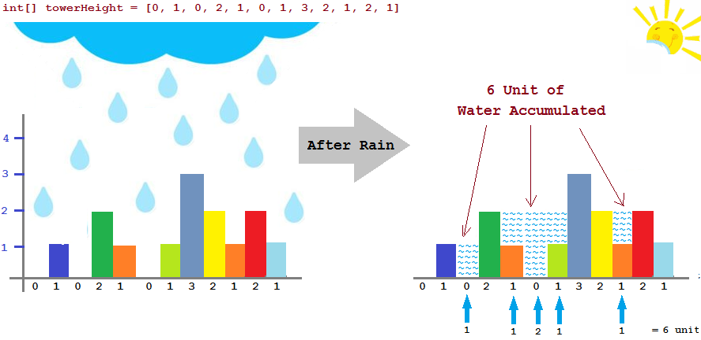

Real-Life Scenario
Water Between Buildings
Think of the aray values as building heights in a city skyline. After a storm, water doesn't stay on top of the tallest building; it flows into the valleys created by neighboring structures.
"The amount of water at any point is limited by the shorter of the two tallest buildings surrounding that point."

Slide 4
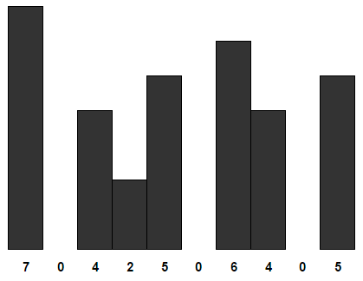

Slide 5
Dry Run Visualization
Index | Height | Max Left | Max Right | Min(L, R) - H | Water
0 | 4 | 4 | 5 | 4 - 4 | 0
1 | 2 | 4 | 5 | 4 - 2 | 2
2 | 0 | 4 | 5 | 4 - 0 | 4
3 | 3 | 4 | 5 | 4 - 3 | 1
4 | 2 | 4 | 5 | 4 - 2 | 2
5 | 5 | 5 | 5 | 5 - 5 | 0
Total Trapped Water = 0 + 2 + 4 + 1 + 2 + 0 = 9 Units

Slide 6
Best Time to Buy and Sell Stock
Maximizing profit with a single transaction strategy.

Slide 7
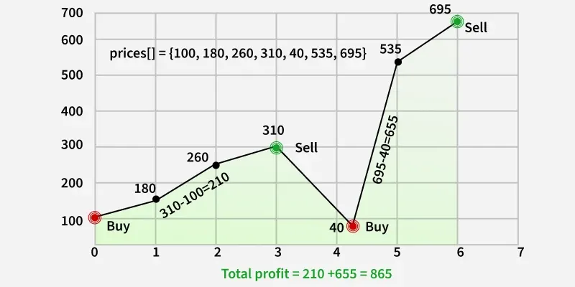
Problem 2: Stock Mastery
You are given an array prices where prices[i] is the price of a stock on day i. You want to maximize profit by picking one day to buy and a later day to sell.
Return the maximum profit you can achieve from the transaction. If you cannot achieve any profit ,return 0;
Input: [7, 1, 5, 3, 6, 4]
Output: 5 (Buy at 1, Sell at 6)
Cannot sell before buying.

Slide 8
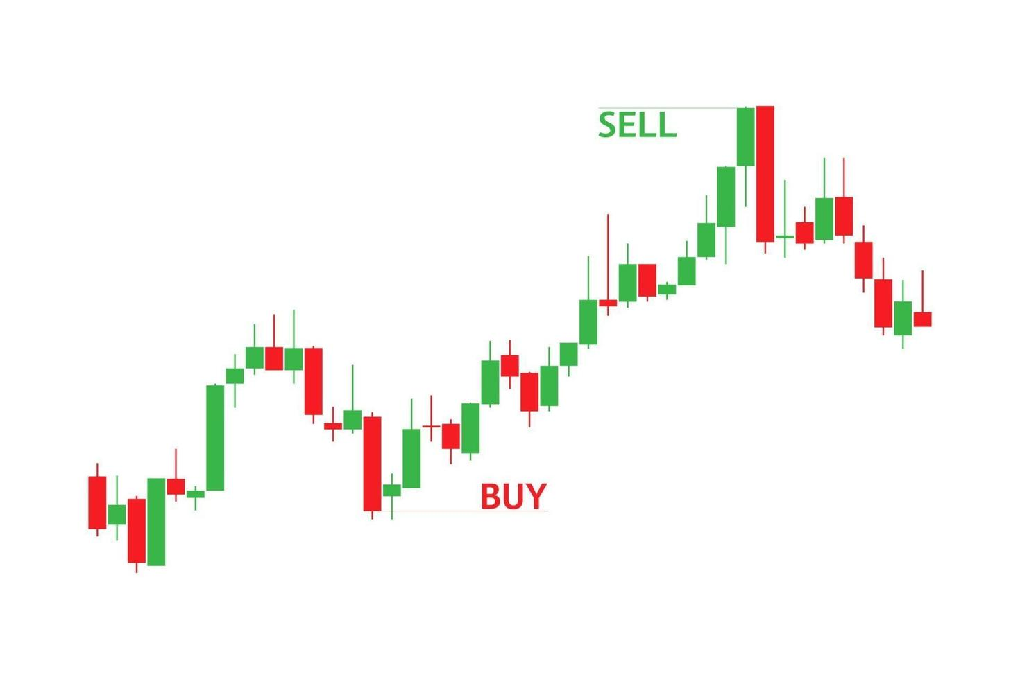
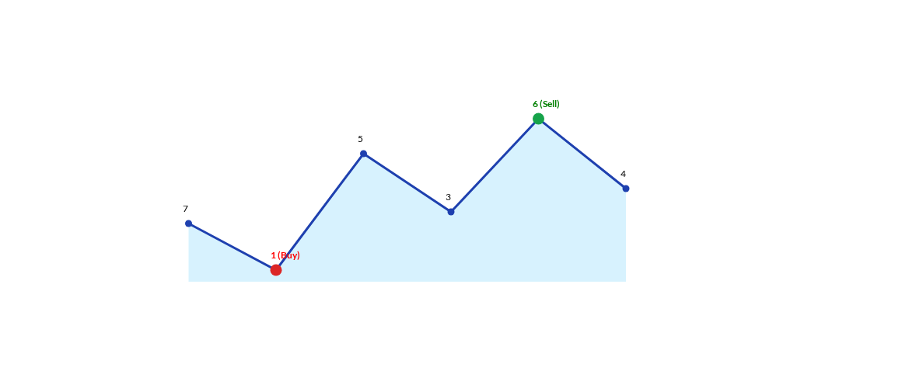
Visualizing the Price Trend
The maximum gap (6 - 1) gives us the profit of 5.

Slide 9
Visualizing the Price Trend
The maximum gap (6 - 1) gives us the profit of 5.

Slide 10
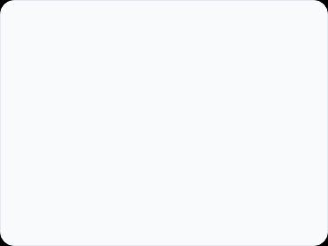
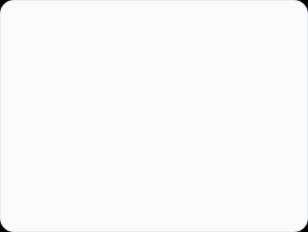



The Single Pass Strategy
1. Track Minimum
2. Calculate Profit
3. Maximize
Iterate through prices and keep track of the lowest price seen so far.
For each price, assume you sell today. Profit = Current - MinPrice.
Maintain a variable to store the highest profit calculated.
Time: O(N) | Space: O(1)

Slide 11
Questions?
Happy Coding! Master these patterns to ace your next technical interview.

